Slide 1
Analysis of Link Reversal Routing Algorithms for Mobile Ad Hoc Networks
Costas Busch (RPI)
Srikanth Surapaneni (RPI)
Srikanta Tirthapura (Iowa State University)

Slide 2
Talk Outline
Link Reversal Routing
Previous Work & Contributions
Analysis of Full Reversal Algorithm
Analysis of Partial Reversal Algorithm
Analysis of Deterministic Algorithms
Conclusions

Slide 3
Link Reversal Routing
Connection graph
of a mobile network
Destination oriented,
acyclic graph
Destination

Slide 4
Link Failure
node moves

Slide 5
A bad state
A good state
Bad node: no path to destination
Good node: at least one path to destination

Slide 6
Full Link Reversal Algorithm
sink
sink
sink
sink
sink
sink
sink
Sinks reverse all their links
#reversals = 7
time = 5

Slide 7
Partial Link Reversal Algorithm
sink
sink
sink
sink
sink
Sinks reverse some of their links
#reversals = 5
time = 5

Slide 8
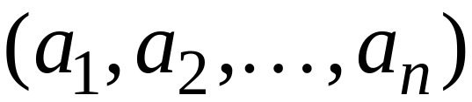


Heights
General height:
higher
lower
Heights are ordered in lexicographic order

Slide 9








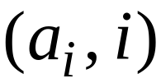
Full Link Reversal Algorithm
Node
Real
height
Node ID
(breaks ties)

Slide 10

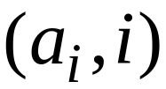
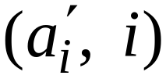
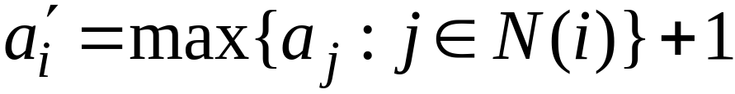
Full Link Reversal Algorithm
Sink
before reversal
after reversal

Slide 11






Full Link Reversal Algorithm

Slide 12







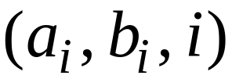
Partial Link Reversal Algorithm
Node
Real
height
memory
Node ID
(breaks ties)

Slide 13



Partial Link Reversal Algorithm
Sink
before reversal
after reversal

Slide 14




Partial Link Reversal Algorithm

Slide 15







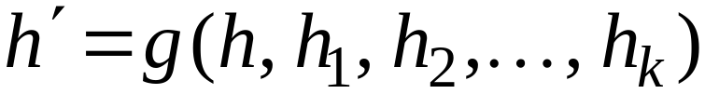
Deterministic Link Reversal Algorithms
Sink
before reversal
after reversal
Deterministic function

Slide 16
Interesting measures:
#reversals: total number of node reversals
(work)
Time: time needed to reach a good state
(stabilization time)

Slide 17
Talk Outline
Link Reversal Routing
Previous Work & Contributions
Analysis of Full Reversal Algorithm
Analysis of Partial Reversal Algorithm
Analysis of Deterministic Algorithms
Conclusions

Slide 18
Previous Work
Gafni and Bertsekas: IEEE Tsans. on Commun. 1981
Introduction of the problem
First proof of stability
Corson and Ephremides: Wireless Net. Jour. 1995
LMR – Lightweight Mobile Routing Alg.
Park and Corson: INFOCOM 1997
TORA – Temporally Ordered Routing Alg.
Variation of partial reversal
  Deals with partitions

Slide 19
Previous Work
Malpani, Welch and Vaidya.: Workshop on Discr. Alg.
And methods for mobile comput. and commun. 2000
Leader election based on TORA
(partial) proof of stability
Experimental work and surveys:
Broch et al.: MOBICOM 1998
Samir et al.: IC3N 1998
Perkins: “Add Hoc Networking”, Ad. Wesley 2000
Rajamaran: SIGACT news 2002

Slide 20
Contributions
First formal performance analysis
of link reversal routing algorithms
in terms of #reversals and time

Slide 21

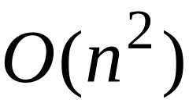
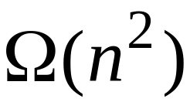
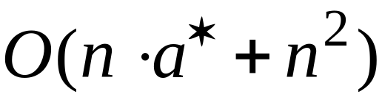
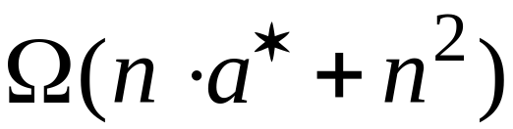

Contributions
bad nodes
Full reversal algorithm:
#reversals and time:
There are worst-cases with:
Partial reversal algorithm:
#reversals and time:
There are worst-cases with:
depends on the network state

Slide 22
Contributions
bad nodes
Any deterministic algorithm:
There are states such that
#reversals and time:
Full reversal is worst-case optimal
Partial reversal is not!

Slide 23
Talk Outline
Link Reversal Routing
Previous Work & Contributions
Analysis of Full Reversal Algorithm
Analysis of Partial Reversal Algorithm
Analysis of Deterministic Algorithms
Conclusions

Slide 24
Bad state
dest.
Good nodes
Bad nodes

Slide 25
Resulting Good state
dest.
For any execution of the full reversal algorithm:
#reversals is the same
Final state is the same
(this holds for any deterministic algorithm)

Slide 26
Bad state
dest.
Good nodes
Bad nodes

Slide 27




Layers of bad nodes
dest.
Good nodes
Bad nodes

Slide 28

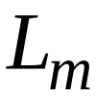
Layers of bad nodes
dest.
A layer:

Slide 29

There is an execution such that:
Every bad node reverses exactly once
dest.

Slide 30
There is an execution such that:
Every bad node reverses exactly once
r
r
dest.
r

Slide 31
There is an execution such that:
Every bad node reverses exactly once
r
r
dest.
r
r
r

Slide 32
There is an execution such that:
Every bad node reverses exactly once
r
r
dest.
r
r
r
r
r
r

Slide 33
At the end of execution :
All nodes of layer become good nodes
The remaining bad nodes return to the
same state as before the execution
r
r
r
r
r
dest.
r
r
r
r
r
r
r

Slide 34
At the end of execution :
All nodes of layer become good nodes
The remaining bad nodes return to the
same state as before the execution
dest.

Slide 35
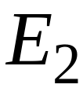
There is an execution such that:
Every bad node reverses exactly once
dest.

Slide 36
At the end of execution :
All nodes of layer become good nodes
The remaining bad nodes return to the
same state as before the execution
dest.

Slide 37
At the end of execution :
All nodes of layer become good nodes
The remaining bad nodes return to the
same state as before the execution
dest.

Slide 38
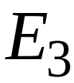
At the end of execution :
All nodes of layer become good nodes
dest.

Slide 39
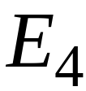

At the end of execution :
All nodes of layer become good nodes
dest.

Slide 40

dest.
Reversals per node:

Slide 41

dest.
Reversals per node:
End of execution

Slide 42

dest.
Reversals per node:
End of execution

Slide 43

dest.
Reversals per node:
End of execution

Slide 44

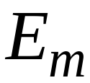
dest.
Reversals per node:
End of execution

Slide 45


dest.
Reversals per node:
Each node in layer reverses times

Slide 46







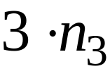
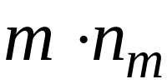
dest.
Reversals per node:
Nodes per layer:
#reversals:

Slide 47


dest.
For bad nodes, trivial upper bound:
(#reversals and time)
#reversals:

Slide 48


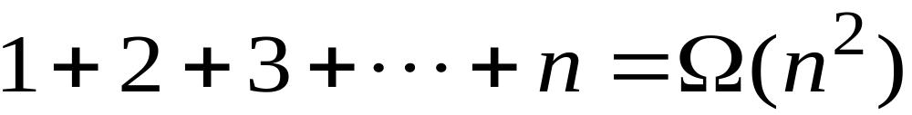
#reversals bound is tight
dest.
Reversals
per node:
#reversals:

Slide 49
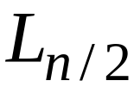
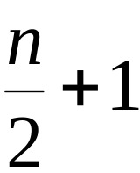
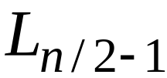
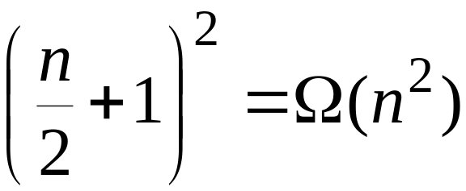

time bound is tight
#nodes =
dest.
#reversals in layer :
Time needed
None of these reversals
are performed in parallel

Slide 50
Talk Outline
Link Reversal Routing
Previous Work & Contributions
Analysis of Full Reversal Algorithm
Analysis of Partial Reversal Algorithm
Analysis of Deterministic Algorithms
Conclusions

Slide 51
Bad state
dest.
Good nodes
Bad nodes

Slide 52


Layers of bad nodes
dest.
Good nodes
Bad nodes
Nodes at layer
are at distance from good nodes

Slide 53
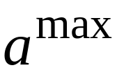
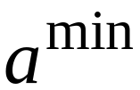
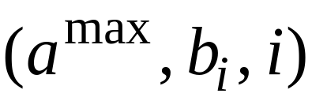
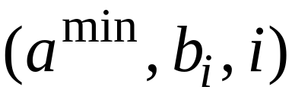
Layers of bad nodes
dest.
alpha value

Slide 54
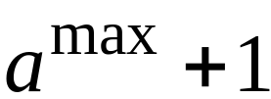



when the network reaches a good state:
dest.
upper bound
on alpha value

Slide 55
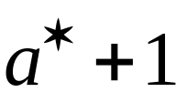
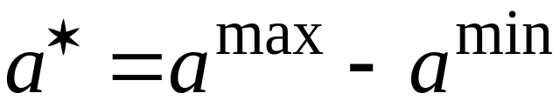
when the network reaches a good state:
dest.
upper bound
on reversals
per node

Slide 56
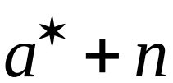
when the network reaches a good state:
dest.
For bad nodes:
a bad node reverses at
most times
#reversals and time:

Slide 57

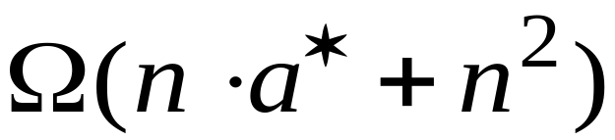
#reversals bound is tight
dest.
Reversals
per node:
#reversals:

Slide 58
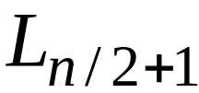
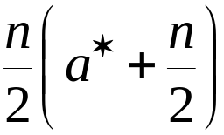

time bound is tight
dest.
#reversals
in layer :
#nodes =
Time needed
None of these reversals
are performed in parallel

Slide 59
Talk Outline
Link Reversal Routing
Previous Work & Contributions
Analysis of Full Reversal Algorithm
Analysis of Partial Reversal Algorithm
Analysis of Deterministic Algorithms
Conclusions

Slide 60
Layers of bad nodes
dest.
Good nodes
Bad nodes
Nodes at layer
are at distance from good nodes

Slide 61
Layers of bad nodes
dest.
for any height function g, there is
an initial assignment of heights such that……

Slide 62

when the network reaches a good state:
dest.
lower bound
on reversals
per node

Slide 63

Lower Bound on #reversals
dest.
Reversals
per node:
#reversals:

Slide 64
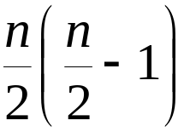
Lower Bound on time
dest.
#reversals
in layer :
#nodes =
Time needed
None of these reversals
are performed in parallel

Slide 65
Talk Outline
Link Reversal Routing
Previous Work & Contributions
Analysis of Full Reversal Algorithm
Analysis of Partial Reversal Algorithm
Analysis of Deterministic Algorithms
Conclusions

Slide 66
We gave the first formal performance
analysis of deterministic link reversal
algorithms
Open problems:
Improve worst-case performance
of partial link reversal algorithm
Analyze randomized algorithms
Analyze average-case performance

